Slide 1
The Cyber Threat Landscape. Introduction to vulnerabilities.
Notes:
The content of the following slide deck is based on the Fortinet course „Introduction to the Threat Landscape” https://training.fortinet.com/local/staticpage/view.php?page=library_introduction-to-the-threat-landscape

Slide 2
Intro
Actors
Threats
Social Engineering
Insider Threat
Malware
Unauthorised Access
System Design Failure
Attack Vectors
Attack Surface
Threat Intelligence
Threat Reports
Threat Landscape
How does it look in real life?

Slide 3
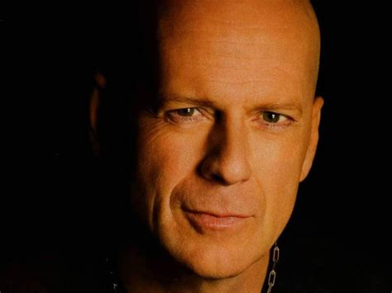

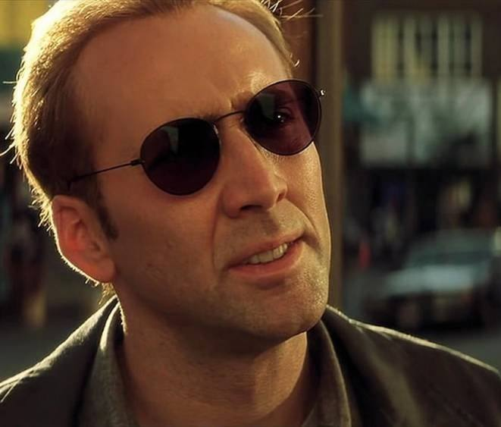
Who are the actors?
Notes:
Source: http://www.actors-pictures.com/pictures/bruce-willis-40.jpg
Source: https://assets.rappler.com/C864E813EBAA4CEC920FC6C97F150ED9/img/44654D08E1064BE8990C16376C6BC5AB/the-devil-wears-prada-01.jpg
Source: https://mafab.hu/static/thumb/w1000/2014t/285/15/45613_36.jpg

Slide 4
Explorer
A.K.A. Script-kiddies
Motivation
Drivers:
Curiosity
Show-off
Test skills
TTP:
Free or commercial hacking tools
Phishing
Opportunistic targeting
Reconnaissance
Risk
Explorers do not intend to inflict serious damage, but they might change a page on a website to embarrass someone or do something to advertise to the world how clever they are.

Slide 5
Hacktivist
Motivation
Drivers:
Beliefs
Publicity
Ideology
Emotions
Risk
TTP:
DDoS, Deface, Doxxing
Ransomware (RaaS)
Public announcements
Propaganda
Short-term focus
Hacktivists are motivated by ideology or are animated by an emotive force. The hacktivists’ idealism drives them to act collectively in common cause against an enemy.
Notes:
Doxxing: The act of publicly revealing personal information (often of government officials, corporate executives, or law enforcement) to expose corruption or wrongdoing.

Slide 6
Cyberterrorist
Motivation
Risk
Drivers:
Ideology
Fear
To intimidate
To Destabilise
TTP:
Custom tools
1 day Exploits
APT
Leaks, sabotage
Targeted attacks
Cyber Terrorists strive to intimidate and destabilize a society by destroying or disrupting computer or communication networks. They like to target online infrastructure, such as nuclear power plants, natural gas pipelines, and electrical power grids.
TLP:CLEAR

Slide 7
Cybercriminal
Drivers:
Money
Motivation
Risk
TTP:
Social Engineering
Identity theft
Ransomware
Opportunistic
Cybercriminals want money plain and simple. To achive this they steal, extort, mislead their victims.

Slide 8
Cyberwarrior
Risk
A.K.A. Nation-State hacker
Drivers:
National Interest
Beliefs or money
Destroy, Distrupt or damage
Motivation
TTP:
Tailor-made tools
Cyber Weapons
Espionage, extortion
0 day Exploits
Cyberwarriors are the least self-interested, but are nonetheless the most dangerous because they have the resources of a nation-state at their disposal. Cyberwarriors are motivated by the national interests of their home country

Slide 9
Threats
A threat is any potential event, action, or entity that can cause harm, damage, or compromise the CIA of a system, person, or organization. In cybersecurity, a threat refers to anything that could exploit a vulnerability to breach security, cause data loss, disrupt services, or cause harm to systems and networks. Threats can be intentional (like hackers or malware) or unintentional (such as system failures or user errors).

Slide 10
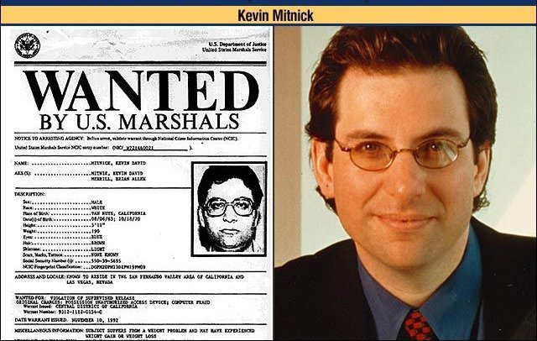
Threats: Social Engineering
Social Engineering is the act of manipulating people to gain advantage, often at the expense of those targeted.
All social engineering attacks are designed to benefit the attacker.
Most well-known Social Engineer: Kevin Mitnick
Techniques:
Language
Sense of urgency
Quid pro quo
Emotions (curiosity, excitement, anger, sadness, guilt)
Remember: People want to help!
Notes:
Picture from: https://www.blackhatethicalhacking.com/wp-content/uploads/2020/09/kevin-mitnick.jpg

Slide 11
Phishing
Phishing is a Social Engineering attack exploits email as the attack vector and that it targets anyone with an email address.
Phishing is simply malicious spam that is sent to as many people as possible with the hope that at least one will be taken in.
Phishing has categorial meaning — it can be used to refer to all electronic social engineering attacks, such as spear phishing, whaling, smishing, and vishing

Slide 12

Spearphishing
Both spear phishing and whaling can be described as a social engineering attack that uses email to target a specific individual or group with the intent of stealing confidential information or profiting in some way.
In a spear phishing attack, the bad actor targets an individual or category of individuals with lower profiles, such as the employees at that security company.
Notes:
Source: https://www.hackerwebsecurity.com/wp-content/uploads/2018/06/spear-phishing.png

Slide 13
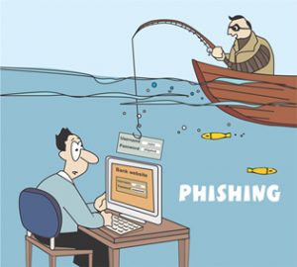
Whaling
Both spear phishing and whaling can be described as a social engineering attack that uses email to target a specific individual or group with the intent of stealing confidential information or profiting in some way.
In a whaling attack, the bad actor targets high-ranking individuals within an organization. When creating a whaling email, the attacker often does research on their target so that they can personalize the email in order to gain their target’s trust.
Notes:
Source: http://www.wikibit.it/wp-content/uploads/2017/03/cosa-significa-phishing-300x270.jpg

Slide 14
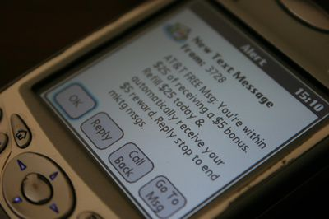
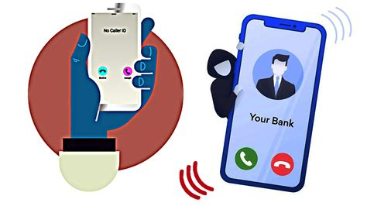
Smishing, vishing
SMS phishing (smsishing) & Voice phihing (vishing)
With SMSishing and vishing are identical to phishing, spear phishing or whaling, except that the attack vectors are different.
Notes:
Source: https://fthmb.tqn.com/NdRBG8FATL8HQuFYjMpR9mCFRbo=/400x0/SMS-Marketing-56a62a2a3df78cf7728ba861.jpg
Source: https://atexnos.gr/wp-content/uploads/2021/07/Vishing-%CF%86%CF%89%CE%BD%CE%B7%CF%84%CE%B9%CE%BA%CF%8C-%CF%88%CE%AC%CF%81%CE%B5%CE%BC%CE%B1.jpg

Slide 15

Pretexting
Pretexting is a type of social engineering attack that involves a situation, or pretext, created by an attacker in order to lure a victim into a vulnerable situation and to trick them
Notes:
Source: https://en.wikipedia.org/wiki/Pretexting
Source: ChatGPT 4.o (Dall-E), prompt: A heart-wrenching scene of an elderly man, George, with gray hair and a wrinkled face, appearing deeply sad and distressed. He is holding a phone in one hand, with tears rolling down his face, realizing he has been tricked. In the background, a shadowy figure representing the attacker is receiving a large amount of money, symbolizing the scam. The setting is dimly lit, with an atmosphere of sadness and deception, focusing solely on George and the scam, excluding any other characters.

Slide 16

Watering hole
Watering hole is a computer attack strategy in which an attacker guesses or observes which websites an organization often uses and infects one or more of them with malware. Eventually, some member of the targeted group will become infected.
Notes:
Source: https://en.wikipedia.org/wiki/Watering_hole_attack
Source: ChatGPT 4.o (Dall-E), prompt: An analogy-based illustration of a watering hole cyberattack, where various animals (representing the targeted organization) are drinking from a watering hole. A crocodile (representing the attacker) is lurking in the middle of the pond, ready to strike, symbolizing the injection of malware. The scene features fewer lions and includes a variety of animals such as antelopes, zebras, or wildebeests. The animals are unaware of the hidden predator in the water, some starting to show signs of illness (representing infected systems). The mood reflects the hidden danger and vulnerability.

Slide 17
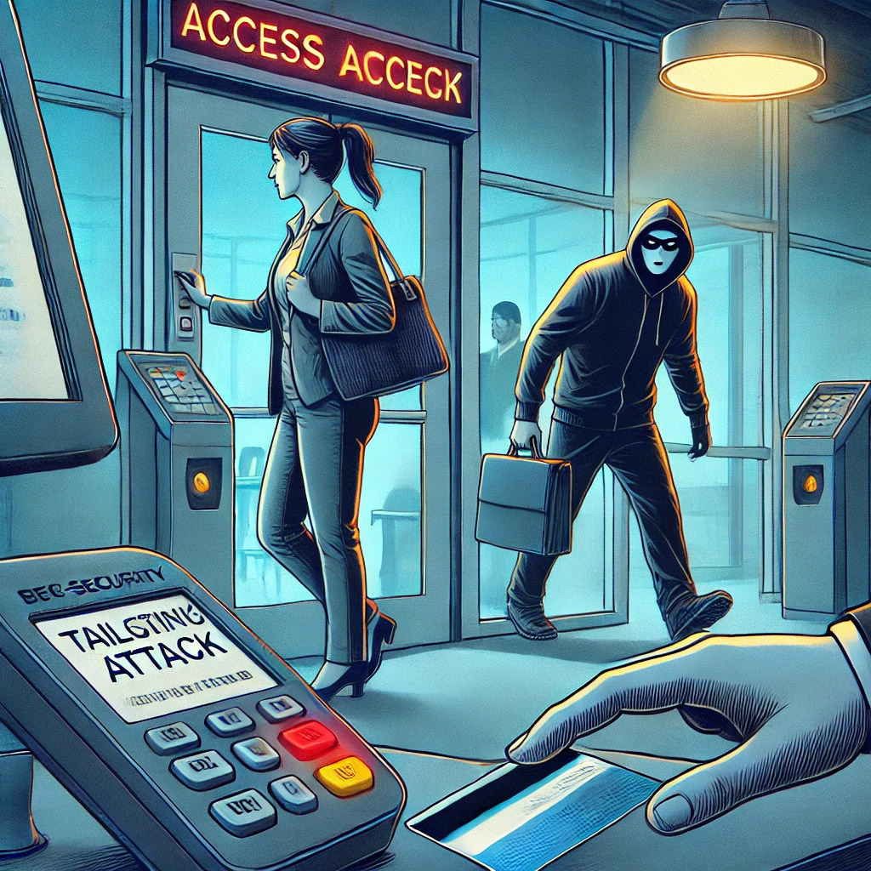
Tailgating
Tailgating involves a bad actor following someone with security clearance into a secure building or an access-controlled room
Notes:
Source: ChatGPT 4.o (Dall-E), prompt: A cybersecurity scene showing a tailgating attack. In the foreground, a person with legitimate security clearance is swiping their access card to enter a secure building or an access-controlled room. Just behind them, a suspicious figure, representing the bad actor, is following closely, sneaking in without proper clearance. The background shows a high-security facility with keycard readers and signs emphasizing restricted access. The overall tone reflects a breach of security, with the bad actor looking determined, while the legitimate person seems unaware.

Slide 18
Threats: Insider Threat
Insider threats
Negligent
Pawn
Goof
Malicious
Moles
Collaborators
Lone wolves
Negligent
No goals, careless action
Goals of Malicious:
espionage
fraud
intellectual property theft
sabotage

Slide 19


Threats: Negligent
The goof is
Arrogant
Ignorant
A pawn is an authorized user who has been manipulated into unintentionally helping the bad actor, often through social engineering techniques, like tailgating or spear phishing.
A goof is an insider who deliberately takes potentially harmful actions but harbors no malicious intent.
Incompetent
Refuses following policies

Slide 20



Threats: Malicious
Attack vectors could be
Tailgating
Shoulder surfing
Mole is an outsider who gain access to the organization by posing as a vendor, partner, contractor, or employee.
Collaborators are authorized users who work with a third party.
Lone wolves work independently and without outside influence.
Dumpster diving
Eavesdropping

Slide 21
Threats: Malware
Virus
Worm
Rootkit
Keylogger
Spyware
Potentially Unwanted Program
Adware
Adversial Artifical Intelligence
Ransomware
Trojan Horse
Botnet Malware
Cryptojacker

Slide 22
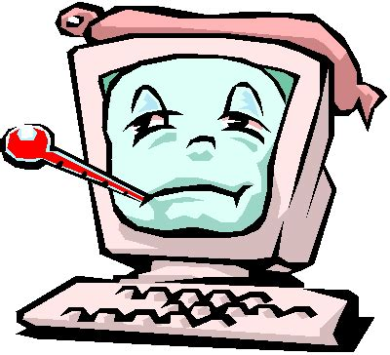
Virus
A computer virus is a type of malicious code or program written to alter the way a computer operates and that is designed to spread from one computer to another. A virus operates by inserting or attaching itself to a legitimate program or document that supports macros in order to execute its code. In the process a virus has the potential to cause unexpected or damaging effects, such as harming the system software by corrupting or destroying data.
Notes:
Source: https://in.norton.com/blog/malware/what-is-a-computer-virus
Source: http://oer.nios.ac.in/wiki/oer/ictapplication/internetanditsusage/a_computer_virus_3.gif

Slide 23
Viruses
Boot sector virus
Virus
Resident virus
Non-resident virus
Network viruses
File infector
Direct action virus
Browser hijacker
Overwrite viruses
Web scripting virus

Slide 24

Worm
Worm malware does not need a host system and can spread between systems and networks without user action, whereas a virus requires a user to execute its code.
Notes:
Source: https://c.pxhere.com/photos/b9/0b/arthropod_giant_tausendf_er_millipedes_giant_centipedes_myriapoda_centipedes_arthropoda_worm-966750.jpg!s

Slide 25

Rootkit
A rootkit is a collection of computer software, typically malicious, designed to enable access to a computer or an area of its software that is not otherwise allowed. A rootkit often masks its existence or the existence of other software. It operates near or within the kernel of the operating system, but it cannot self-replicate or spread across systems.
Notes:
Source: https://jm33.me/img/apt.jpg

Slide 26

Keylogger
A keylogger is a computer program that records every keystroke made by a computer user, with the purpose of gaining fraudulent access to passwords and other confidential information. Keyloggers are a type of spyware, which is malware designed to spy on victims. Because they can capture everything you type, keyloggers are one of the most invasive forms of malware.
Notes:
Source: https://cdn1.vogel.de/unsafe/540x0/smart/images.vogel.de/vogelonline/bdb/1335100/1335139/original.jpg

Slide 27

Potentially Unwanted Program
A potentially unwanted program (PUP) is a program that may be unwanted, despite the possibility that a user consented to download it. PUPs include spyware, adware, and dialers, and are often downloaded in conjunction with a program that the user wants.
Notes:
Source: https://cdn1.vogel.de/unsafe/540x0/smart/images.vogel.de/vogelonline/bdb/1423700/1423731/original.jpg

Slide 28

Spyware
Spyware is malware that obtains covert information about a user’s computer activities by transmitting data secretly from the hard drive. Spyware is a type of malware that collects personal information and gathers data about a user without consent
Notes:
Source: https://junputh.com/wp-content/uploads/2021/07/4-Common-Types-of-Spyware-and-How-to-Detect-Them-1.jpg

Slide 29

Adware
Adware is a form of malware that hides on a device and displays ads. Some adware also monitors a user’s online behaviour so it can target them with specific ads.
Notes:
Source: https://1.bp.blogspot.com/-UkB1wZ18AhQ/Wfug4YN5H6I/AAAAAAAAHEQ/_zE90LKCLTIdUPa-kYP8GWCovjP4aIjigCLcBGAs/s1600/virus%2Bpc.png

Slide 30
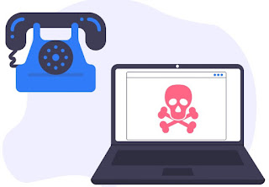
Dialer
A dialer is a malicious program that is installed on a computer and tries to use the dialing features, often running up expensive phone bills for the victim. A dialer is unlike other types of spyware, though it is sometimes included with free software downloads.
Notes:
Source: https://1.bp.blogspot.com/-u3k6EE3LFfs/X8aCSgrh0aI/AAAAAAAAkIw/JL8ymEGwDH45EWhA-fGfHg3lxdGov4hBACLcBGAsYHQ/w320-h222/Dialers.jpg

Slide 31

Adversial Artifical Intelligence
Adversarial machine learning is a technique used in machine learning to fool or misguide a neural network with malicious input. Adversarial artificial intelligence uses specialized inputs created for the purpose of confusing a neural network, resulting in the misclassification of an input. These notorious inputs can be indistinguishable to the human eye but cause the network to fail to correctly identify an image.
Notes:
Source: https://upload.wikimedia.org/wikipedia/commons/1/1c/Artificial_intelligence_prompt_completion_by_dalle_mini.jpg

Slide 32

Ransomware
Ransomware is a type of virus that encrypts or prevents access to the information on a computer and restores access only after the user pays a ransom.
Notes:
Source: https://diggita.com/modules/auto_thumb/2017/05/16/1594859_ransomware.jpg

Slide 33
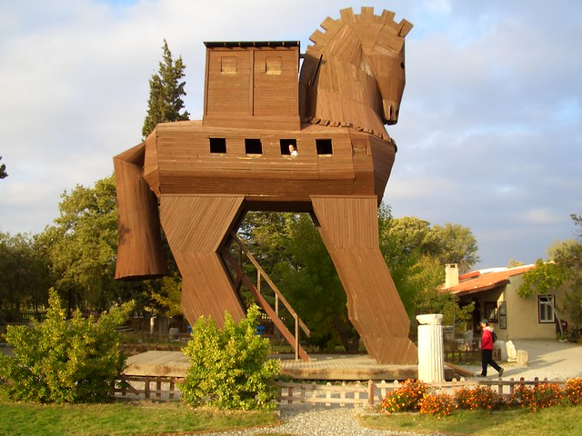
Trojan Horse
A Trojan horse virus is a virus disguised to look like something it is not. For example, viruses can be hidden within unofficial games, applications, file-sharing sites, and bootlegged movies. A remote access Trojan (RAT) virus is Trojan malware that can remotely control an infected computer.
Notes:
Source: http://farm1.staticflickr.com/28/65664836_9a8bcf3ee1_z.jpg

Slide 34

Dropper
A dropper is a type of Trojan horse that is designed to install malware on a computer. Once the dropper is installed, two things can happen: The dropper installs the embedded malware, or the dropper downloads the malware to the targeted computer.
Notes:
Source: ChatGPT 4.o (Dall-E). Prompt: A visual representation of a cybersecurity dropper Trojan, showing an actual dropper device. The dropper is positioned over an integrated circuit on a computer motherboard, symbolizing malware being dropped onto the system. As the dropper releases liquid or code, it turns into malicious-looking digital code or symbols that begin to infect the integrated circuit. The background includes abstract data streams or circuit patterns, emphasizing the digital attack. The overall tone should feel technical and ominous, representing a stealthy cyber attack.

Slide 35
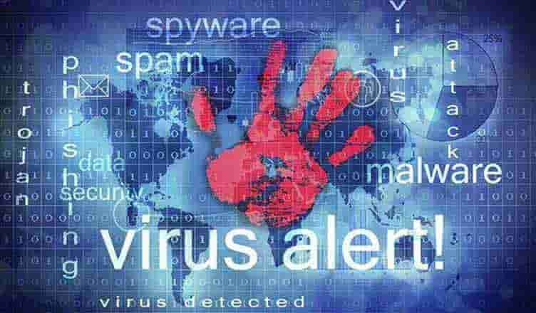
Rogueware / Scareware
Rogue security software, also known as rogueware or scareware, misleads a user into believing that there is malware on their computer and then prompts them to pay for antimalware, which is either fake or malware.
Notes:
Source: https://diggita.com/modules/auto_thumb/2017/02/16/1581650_Come-rimuovere-falsi-antivirus-i-Rogueware-min.jpg

Slide 36
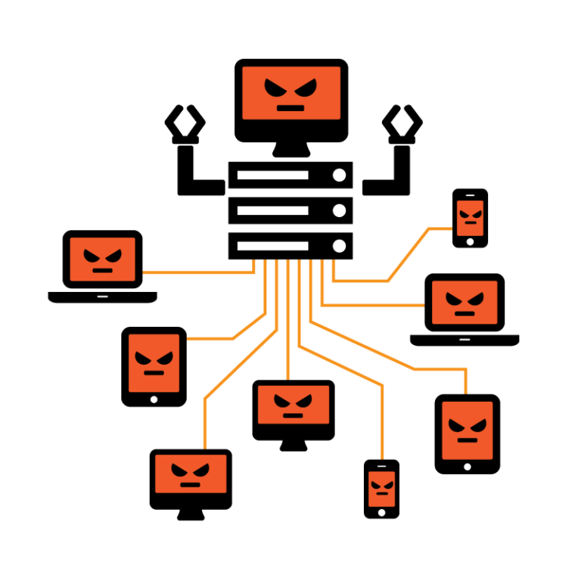
Botnet Malware
Botnet malware controls its infected host through a command and control (C&C) server. An infected computer is named a bot, or robot, and a collection of infected computers is known as a botnet.
Notes:
Source: https://2.bp.blogspot.com/-87vB43FWOxE/W2SG8PkxDcI/AAAAAAABJLg/09lsSvKCzp4fw7HTh0Z9jFB7TF-wK_6sACLcBGAs/s1600/botnet.png

Slide 37

Cryptojacker
Cryptojacking is the illegal use of computing resources to mine cryptocurrency. Attackers use malware or scripting to hijack a computer. For example, Coinhive was a cryptocurrency mining service that allowed website owners to embed JavaScript code on their websites, which hijacked the resources of connected computers for cryptomining purposes. This type of exploit is called in-browser mining.
Notes:
Source: https://images.pexels.com/photos/5126268/pexels-photo-5126268.jpeg?auto=compress&cs=tinysrgb&dpr=2&h=750&w=1260

Slide 38
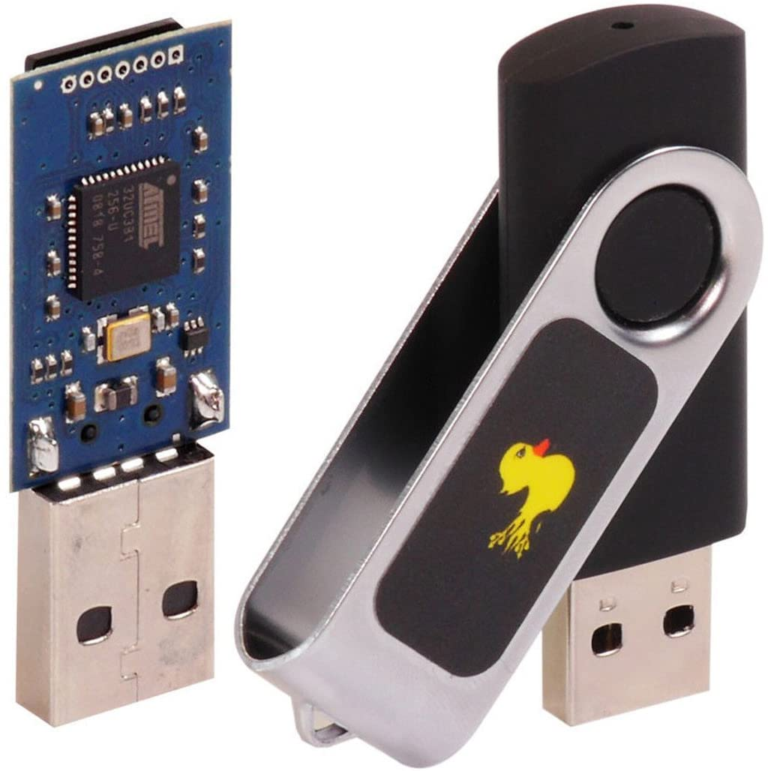
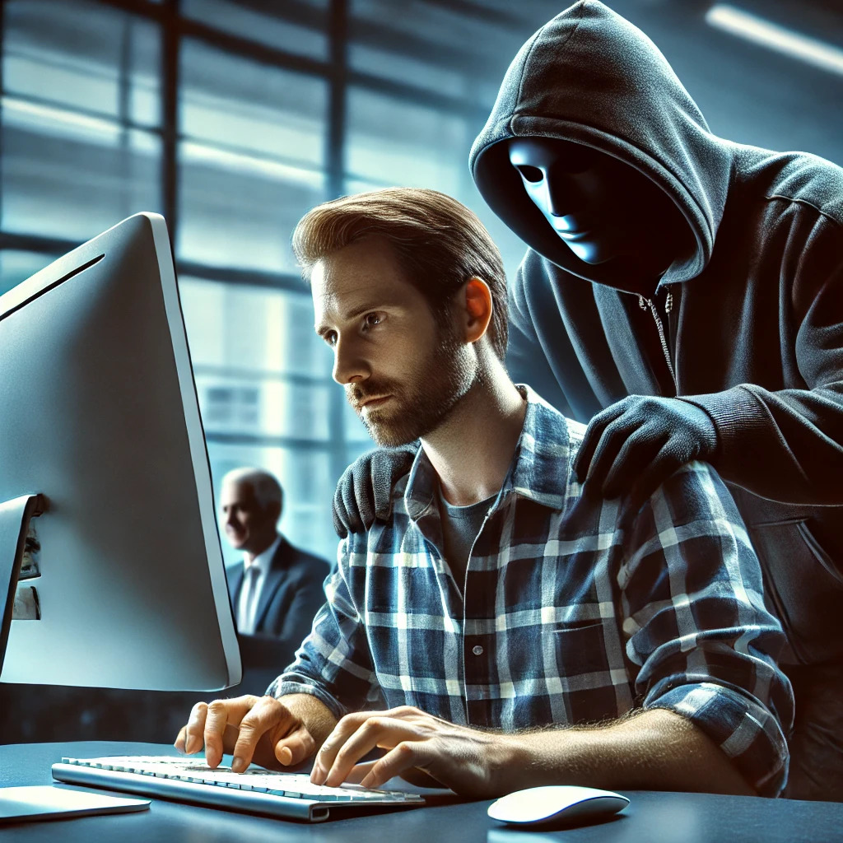
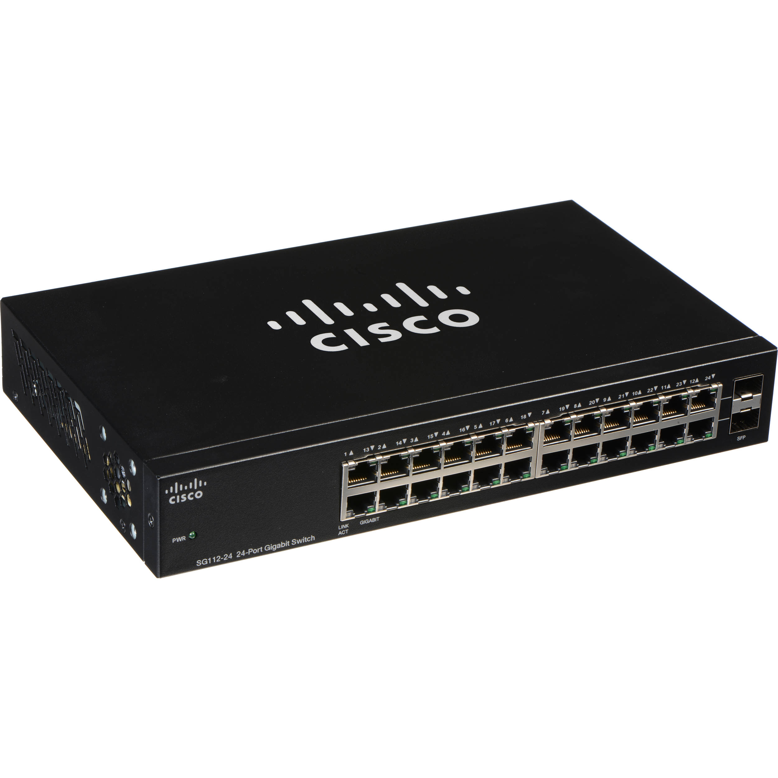
Threats: Unauthorised Access
…to physical places …to computer systems
Notes:
Source: ChatGPT 4.o (Dall-E). Prompt: A visual representation of shoulder surfing in cybersecurity, showing a person typing on a computer, with a 'bad guy' figure directly behind them, looking over their shoulder. The bad guy's face is visible, slightly shadowed or ominous, clearly watching the screen as the person types in credentials. The scene should evoke a sense of stealth and danger, with the bad guy looming over the shoulder of the unaware person. The background could hint at a public space like an office or cafe, creating an atmosphere of caution and risk.
Source: https://www.bhphotovideo.com/images/images2500x2500/cisco_sg112_24_na_sg112_24_110_series_24_port_1204486.jpg
Source: ChatGPT 4.o (Dall-E). Prompt: A cybersecurity scene showing a tailgating attack. In the foreground, a person with legitimate security clearance is swiping their access card to enter a secure building or an access-controlled room. Just behind them, a suspicious figure, representing the bad actor, is following closely, sneaking in without proper clearance. The background shows a high-security facility with keycard readers and signs emphasizing restricted access. The overall tone reflects a breach of security, with the bad actor looking determined, while the legitimate person seems unaware.
Source: https://i2.wp.com/hackwise.mx/wp-content/uploads/2021/08/71qvJRO9rL._AC_SL1300_.jpg?fit=1024%2C1028&ssl=1

Slide 39
Threats: System Design Failure
System design failure is a security flaw in a computer system or application that the bad actor exploits to gain access to a computer system.
Stored clear passwords
Reused unsafe code
Lack of input validation
Use of inadequate variables

Slide 40
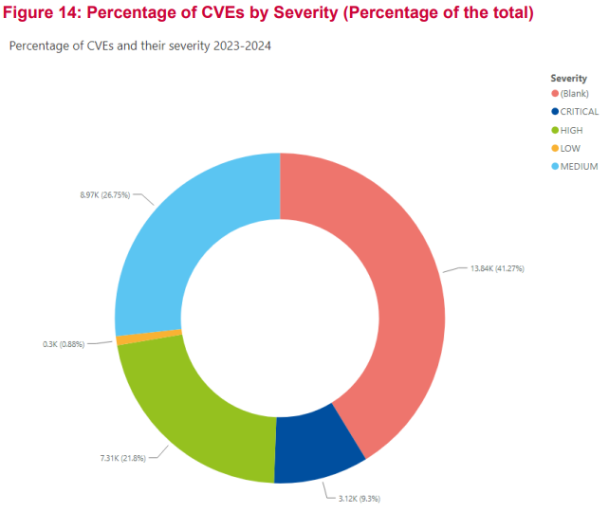
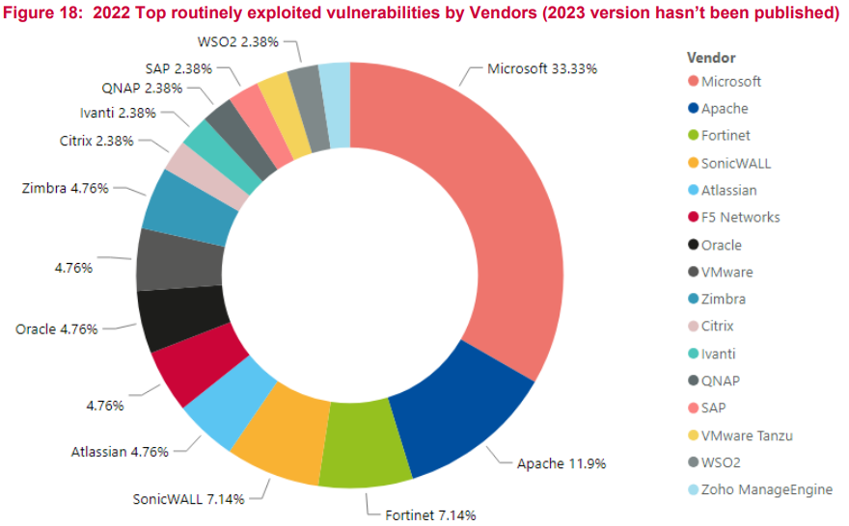
Vulnerabilities
Notes:
Source: ENISA Threat Report 2024 (https://www.enisa.europa.eu/publications/enisa-threat-landscape-2024)

Slide 41
Attack Vector
Attack vector
Vulnerability
Mechanism
Pathway
An attack vector is the method used to attack a target. It can be either a specific Method or Category of attack
Attack Method
SQLi
DDoS
XSS
Attack category
Social Engineering
Malware attacks
Supply chain attacks
Vulnerability | Mechanism | Pathway
Server | Botnet | Internet
Buffer overflow | Backdoor | Watering hole
Open database | Logic bomb | Human

Slide 42
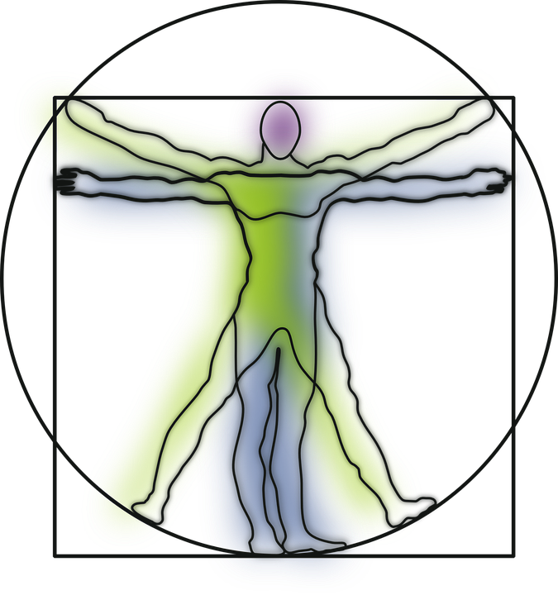





Attack Surface
TLP:CLEAR
Notes:
Source: https://cdn.pixabay.com/photo/2013/07/12/17/15/vitruvian-man-151866_960_720.png
Source: https://upload.wikimedia.org/wikipedia/commons/thumb/a/a3/PEO_Soldier_Enhanced_Combat_Helmet_profile.jpg/1200px-PEO_Soldier_Enhanced_Combat_Helmet_profile.jpg
Source: https://pngimg.com/uploads/bulletproof_vest/bulletproof_vest_PNG40.png
Source: https://cdn.pixabay.com/photo/2017/09/24/11/59/password-2781614_1280.jpg
Source: https://technofaq.org/wp-content/uploads/2018/12/word-image-16-1024x678.jpeg
Source: https://www.globo.tech/learning-center/wp-content/uploads/2014/03/Picture_Firewall.png

Slide 43
What is Threat Intelligence?
„Threat intelligence is evidence-based knowledge, including context, mechanisms, indicators, implications and actionable advice, about an existing or emerging menace or hazard to assets that can be used to inform decisions regarding the subject's response to that menace or hazard.”
Gartner, 16 May 2013
Notes:
https://www.gartner.com/en/documents/2487216

Slide 44
What is Threat Intelligence?
Relevant
Actionable
Contextual

Slide 45
Where do I find Intelligence?
Internal sources
Private sources
OSINT
server logs, network device logs, past incident reports, captured network traffic
Reliability
TI providers, Communities (FIRST, CNW)
GreyNoise, ENISA, CISA, NIST, CVSS
Notes:
https://github.com/enisaeu/IRtools/blob/master/information_sources.md
https://www.greynoise.io/

Slide 46
I have Intelligence, what’s next?
Mass of intelligence
All (relevant, actionable, contextual) intelligence
Identify primary threats
Consider risk appetite, Sector, geographical location, exposure
Assemble information
Collect information related to primary threats
Process and analyse the information
DON’T forget to SHARE!

Slide 47

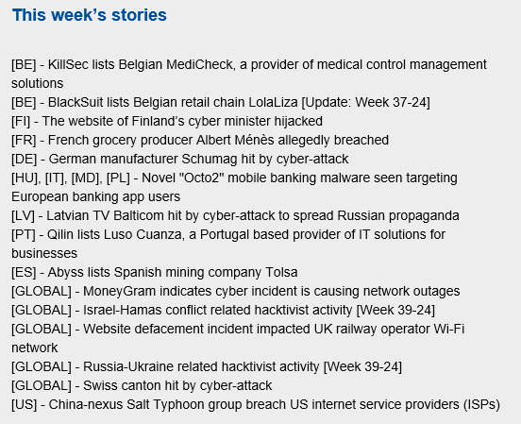
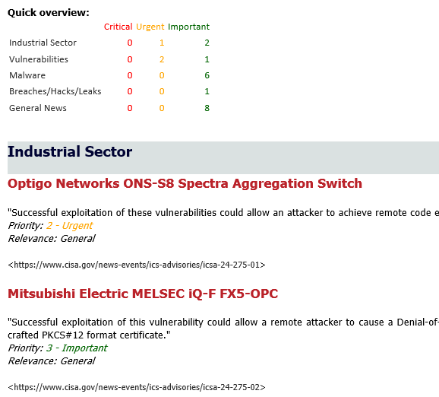
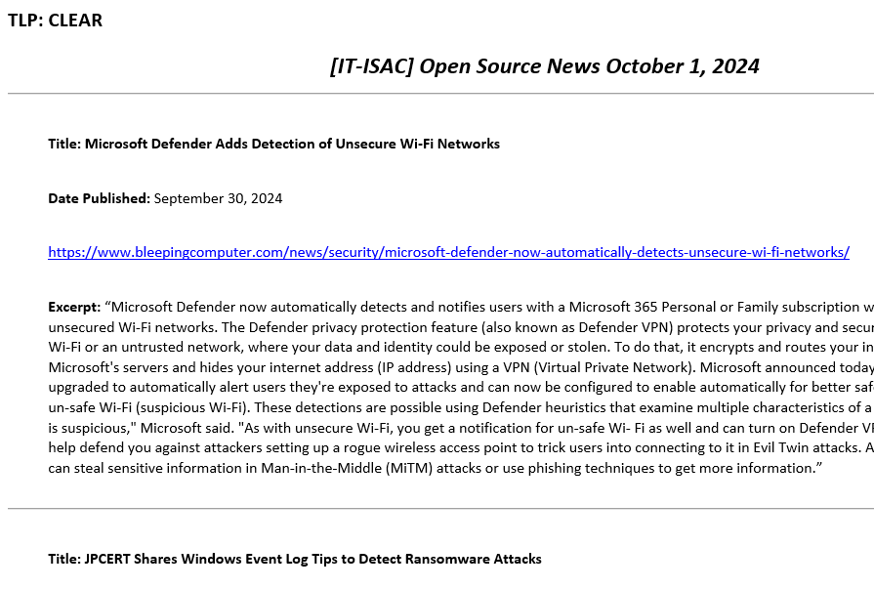
Threat Reports
TLP:GREEN
Notes:
TLP:GREEN = Limited disclosure, recipients can spread this within their community. Sources may use TLP:GREEN when information is useful to increase awareness within their wider community. Recipients may share TLP:GREEN information with peers and partner organizations within their community, but not via publicly accessible channels. TLP:GREEN information may not be shared outside of the community. Note: when “community” is not defined, assume the cybersecurity/defense community

Slide 48
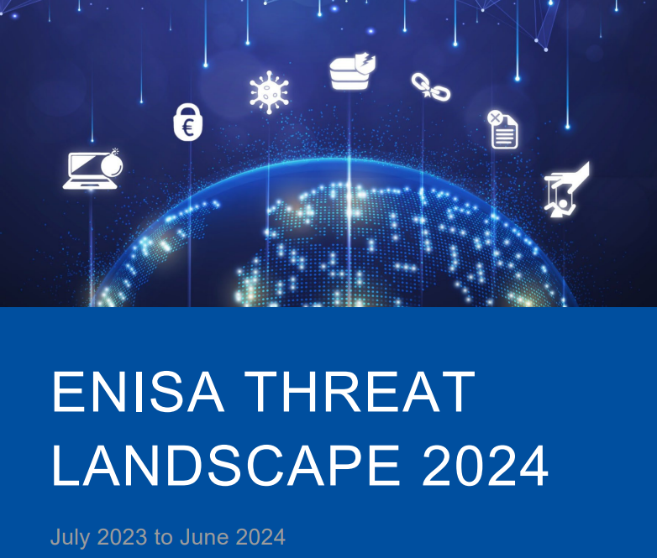
ENISA Threat Landscape
7 prime cybersecurity threats were identified, with threats against availability topping the chart and followed by ransomware and threats against data, and the report provides a relevant deepdive on each one of them by analysing several thousand publicly reported cybersecurity incidents and events:
Ransomware
Malware
Social Engineering
Threats against data
Threats against availability: Denial of Service
Information manipulation and interference
Supply chain attacks
Notes:
https://www.enisa.europa.eu/publications/enisa-threat-landscape-2024

Slide 49
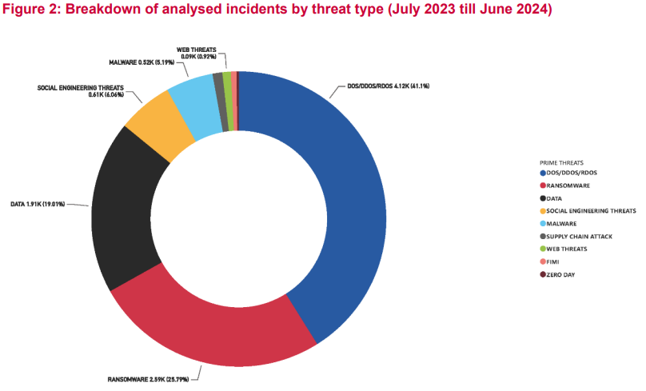
ETL 2024
„AI tools for cyber criminals: Threat actors used tools such as FraudGPT and large language models to co-author scam emails and generate malicious PowerShell scripts.„
„The ongoing regional conflicts still remain a significant factor shaping the cybersecurity landscape. The phenomenon of hacktivism has seen steady expansion, with major events taking place (e.g. European Elections) providing the motivation for increased hacktivist activity”
„The threat of AI-enabled information manipulation has been observed…”
Notes:
https://www.enisa.europa.eu/publications/enisa-threat-landscape-2024

Slide 50
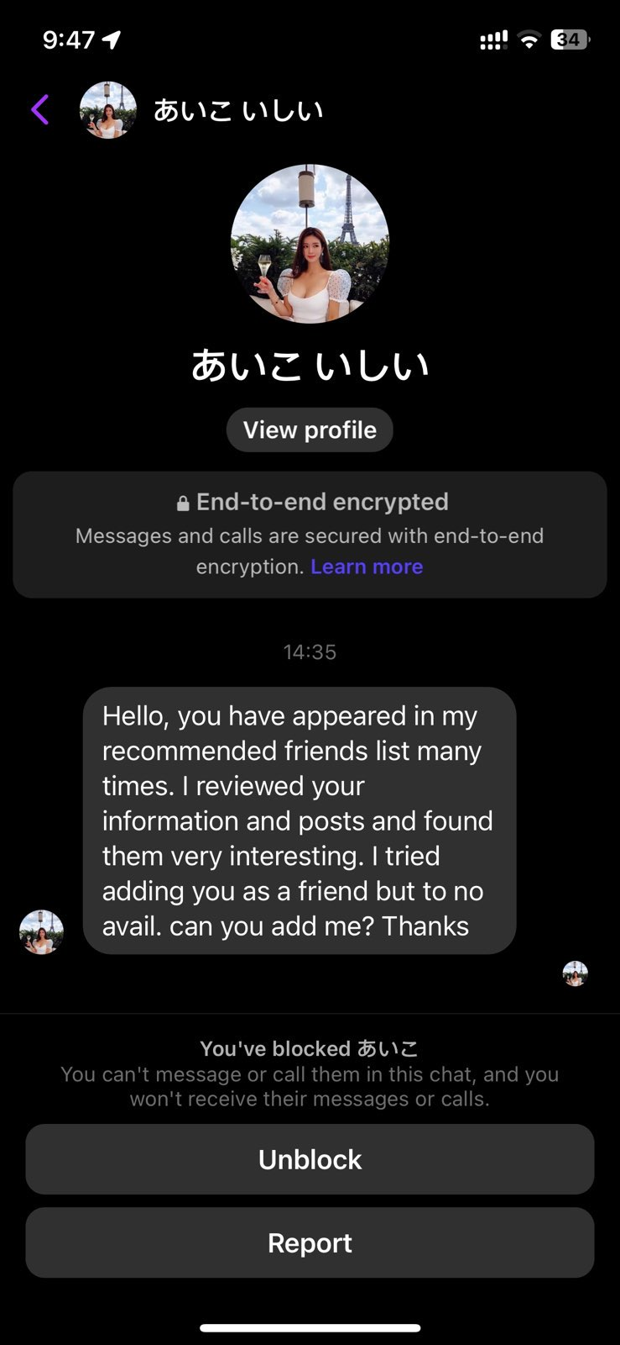
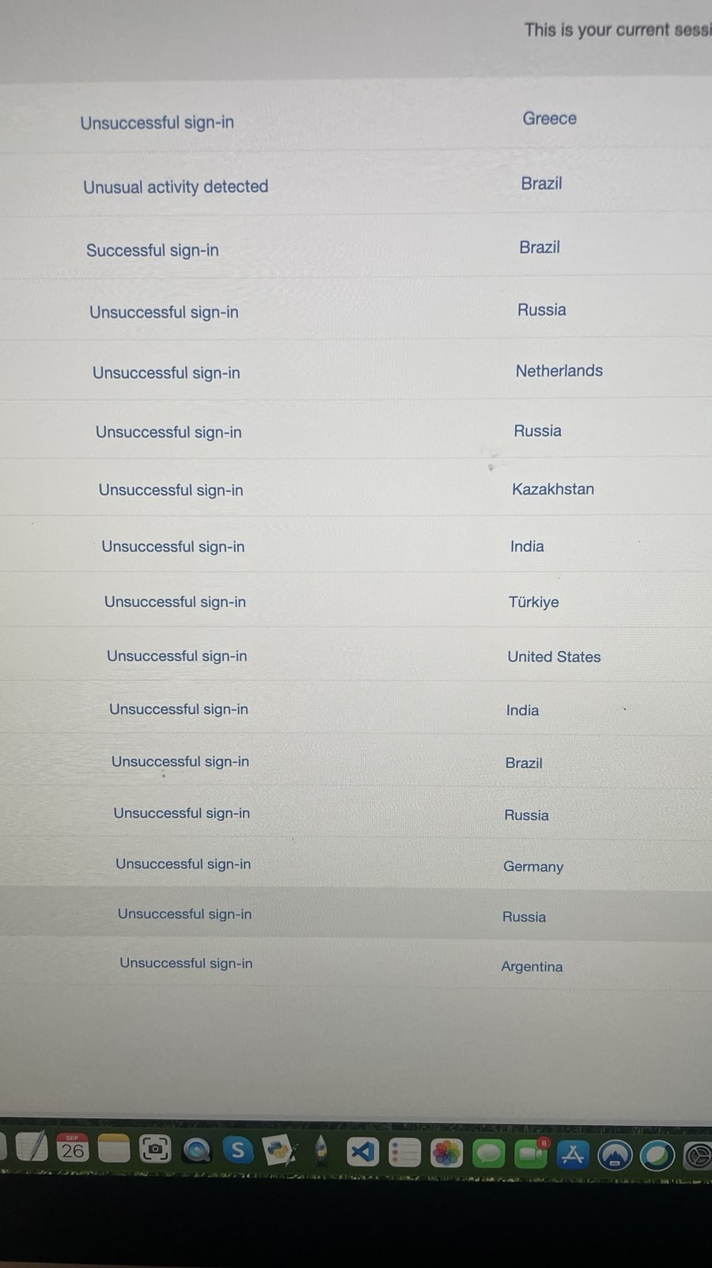
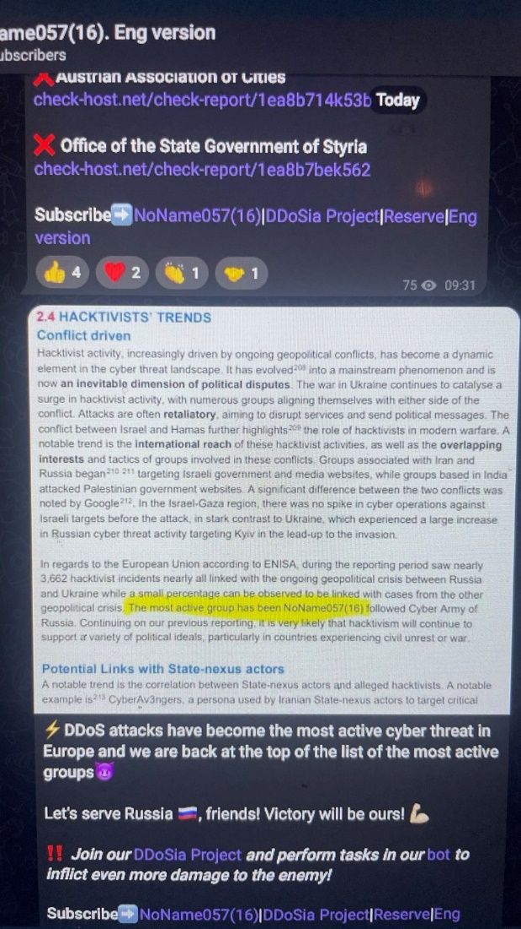
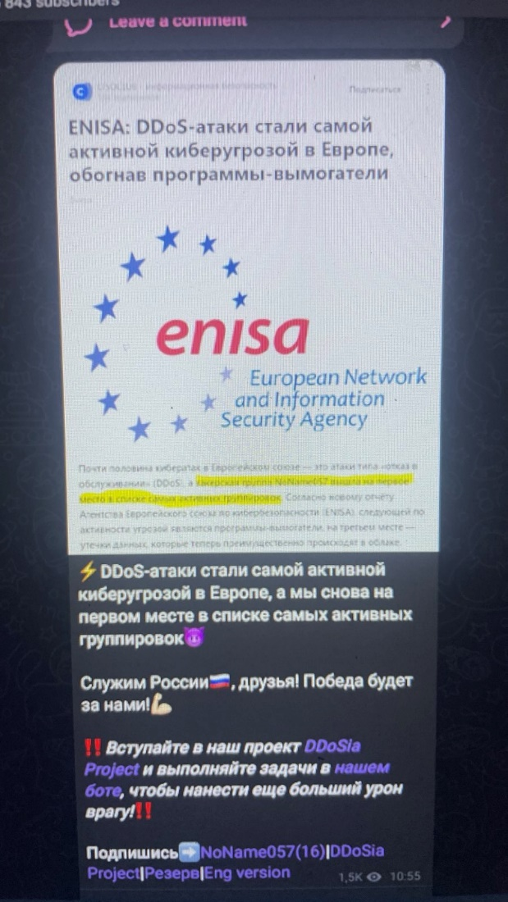
Is it real?

Slide 51

Thank you for your time!
This Photo by Unknown Author is licensed under CC BY-NC-ND
Notes:
This Photo by Unknown Author is licensed under CC BY-NC-ND

